Slide 1
ESHA JAISWAL

Slide 2
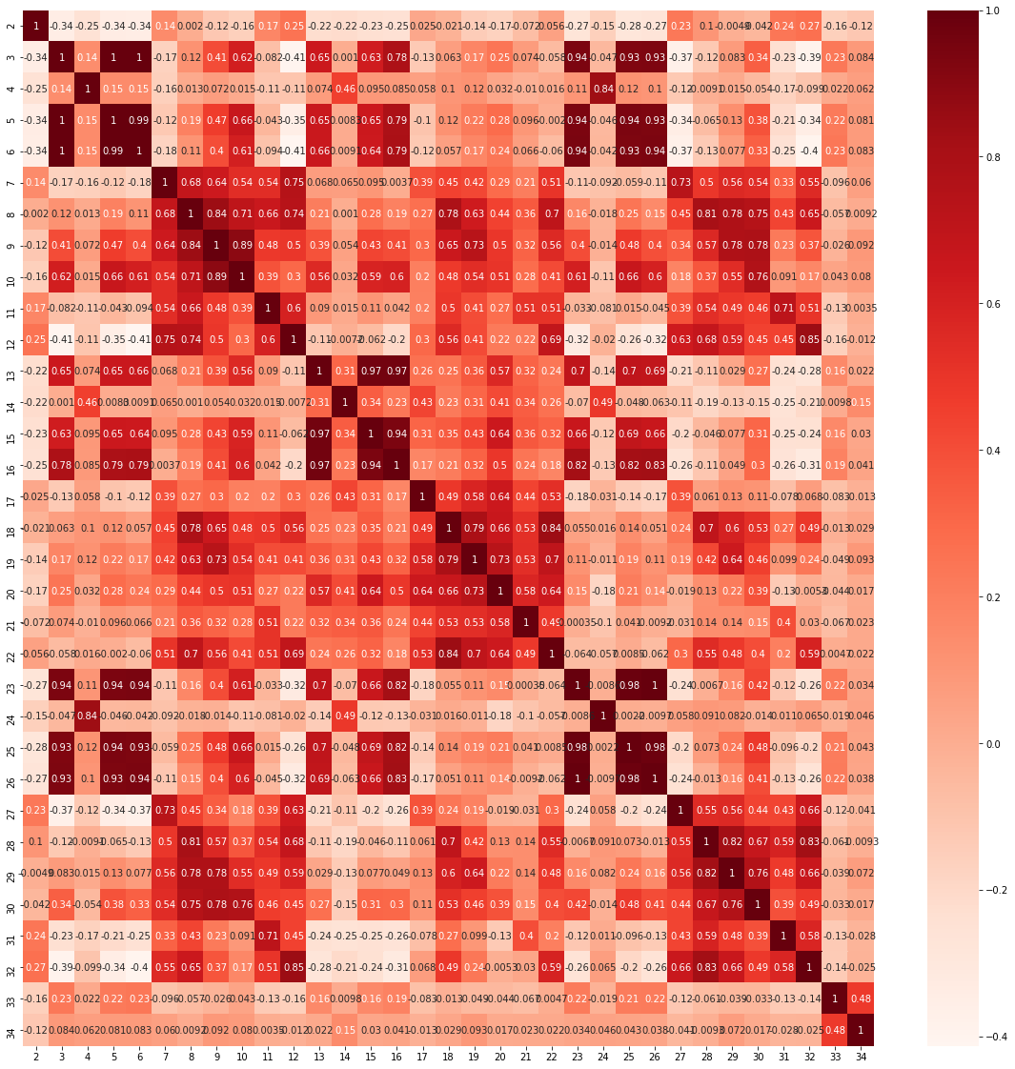
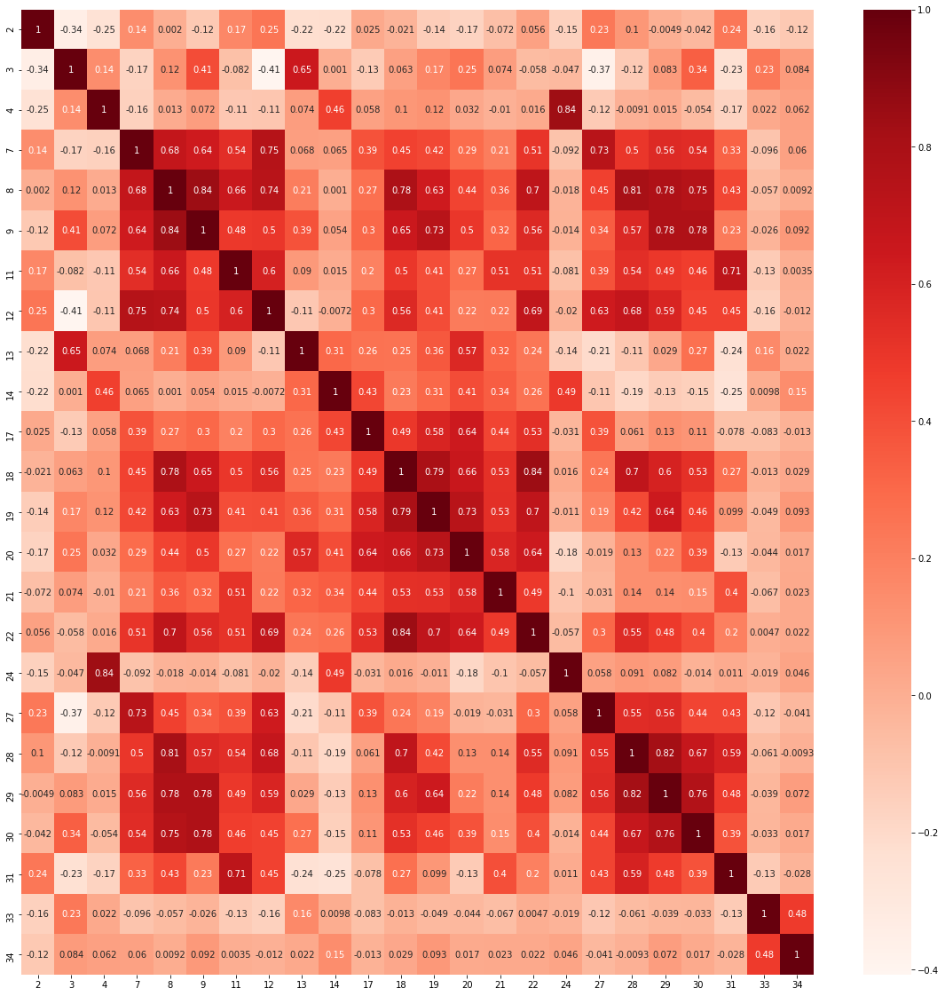
ONLY FEATURES WITH Corr<0.9
ALL FEATURES OBSERVED
(A)CORRELLATION MATRIX

Slide 3
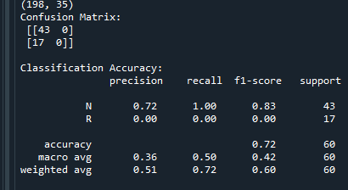
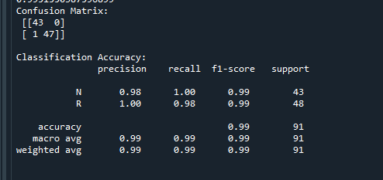
Shape of data : (198, 35)
Small Dataset
X – all features with corr < 0.90
Y – to be predicted
Prediction using Logistic Regression
All False Negatives here. Due to IMBALANCED CLASSES (N – majority, R - minority )
Tried UPSAMPLING, DOWNSAMPLING, RANDOMFORESTCLASSIFIER
INFERENCE :
UPSAMPLING – of ‘R’ to 151 then, divided into training and test (0.30) dataset , then, RANDOMFORESTCLASSIER for classification
RESULT :
(A) ALGORITHM

Slide 4
(A) RESULT
From confusion matrix , Number of false negatives = 1 (out of 48)
Accuracy = 99%
All samples of ‘N’ correctly classified
47 / 48 of ’R’ correctly classified
Prediction2. xlsx

Slide 5
